Slide 1
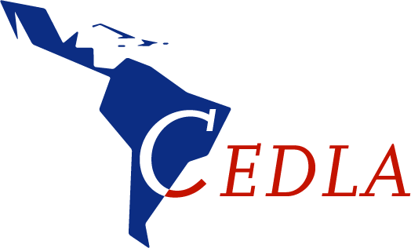
SDGs: Doelen en Dilemma’s
5 Feb 2019
Prof. dr. Barbara Hogenboom
CEDLA-UvA

Slide 2
A Look at the Sustainable Development Goals
https://www.youtube.com/watch?v=ZayhZdSquJk

Slide 3
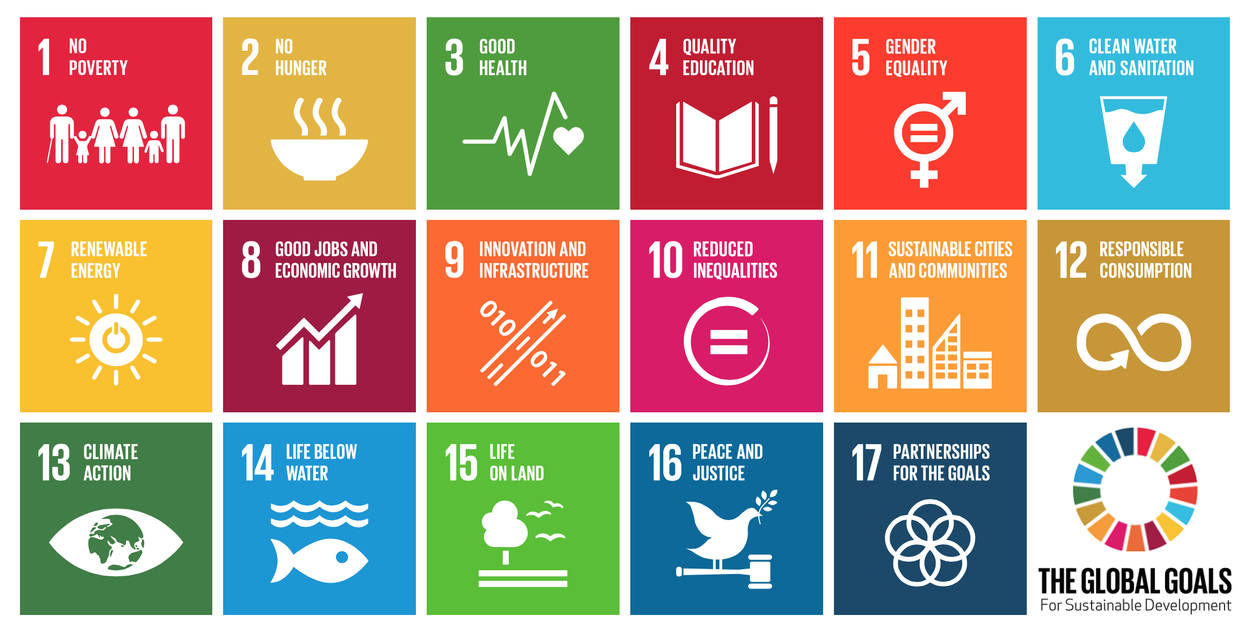

Slide 4
SDG’s
17 doelen opgesteld in 2015, te behalen in 2030
169 targets voor inhoud en diepgang
232 indicatoren linken databases aan de targets om het meten van vooruitgang mogelijk te maken
MAAR: wat hebben we er aan?

Slide 5
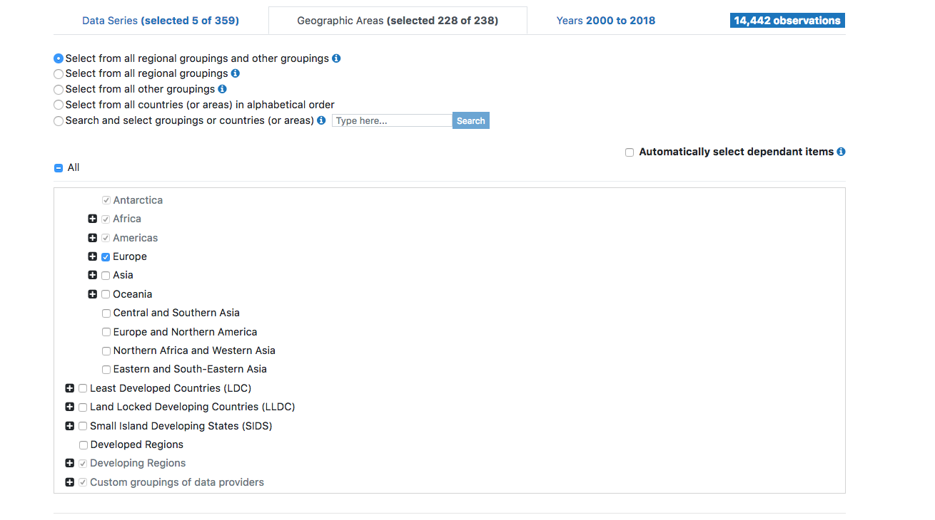
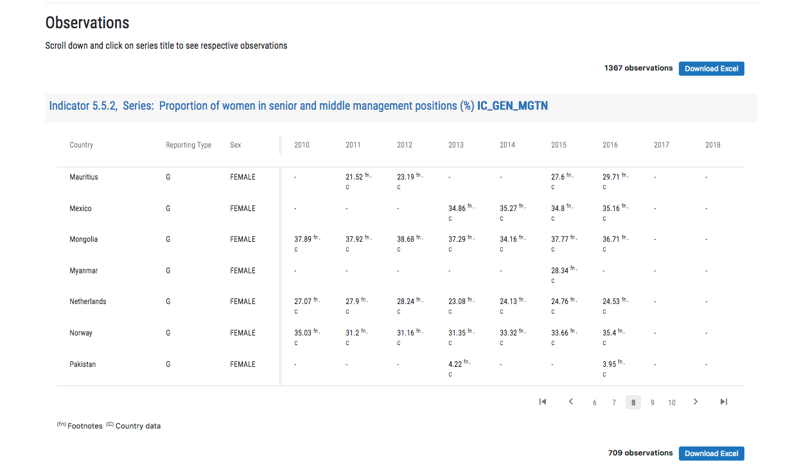
Indicatoren en database
https://unstats.un.org/sdgs/indicators/database/

Slide 6
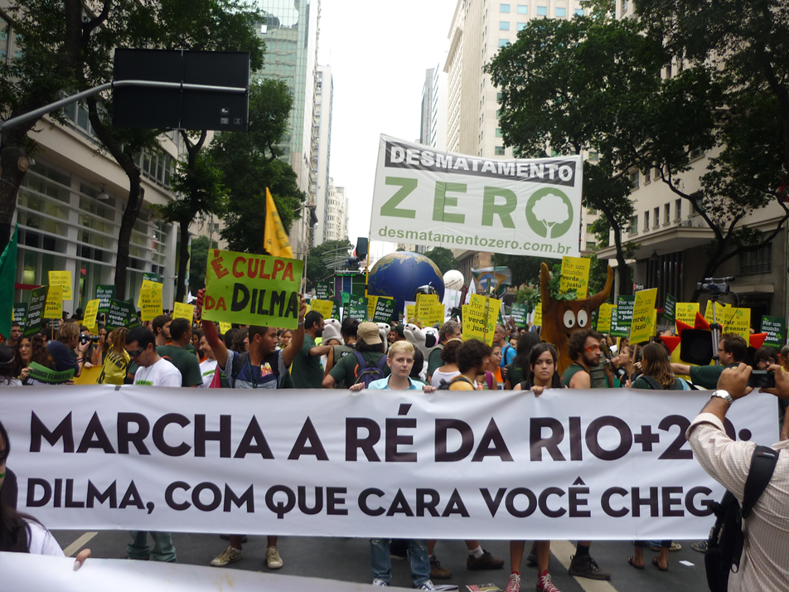
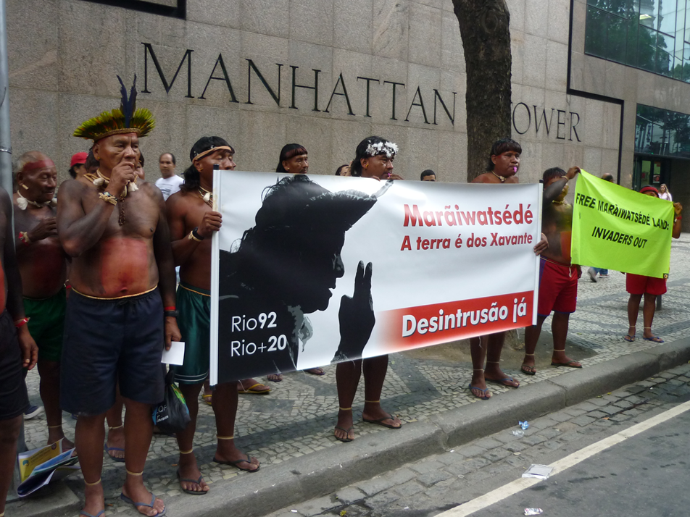
Waar komen ze vandaan?
Twee jaar lang bediscussieerd in de VN
Ondertekend door bijna alle landen (193 lidstaten)
Opvolger van de Millennium Doelen

Slide 7
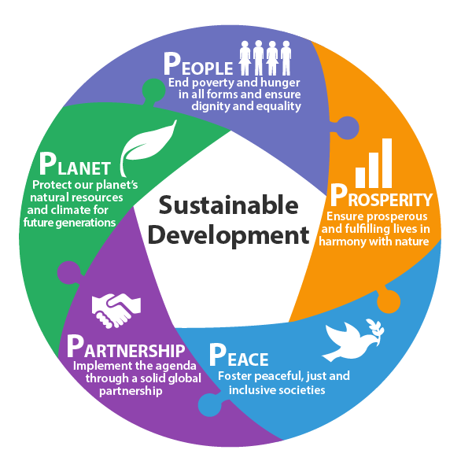
Wat is duurzame ontwikkeling?
Een ontwikkeling die voorziet in de behoeften van de huidige generatie, zonder dat daarmee de behoeften van toekomstige generaties, zowel hier als in andere delen van de wereld, in gevaar worden gebracht.
Notes:
“Brundtland Commissie” (VN), World Commission on Environment and Development, rapport Our Common Future (1987 = 32 jaar geleden)

Slide 8
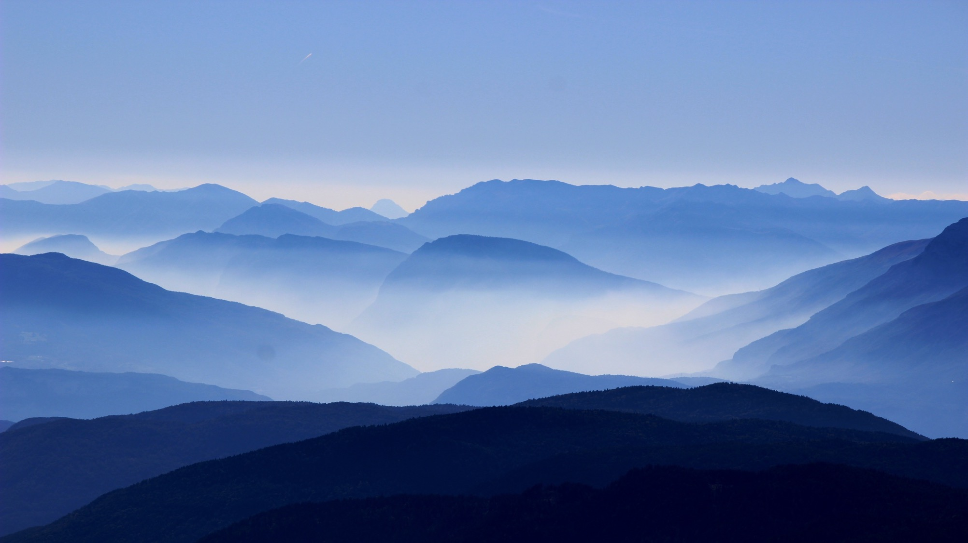
Wat zijn dan duurzame doelen?
Ecologisch houdbaar
Economisch een langetermijnperspectief
Rechtvaardige en stabiele sociale verhoudingen opleveren

Slide 9
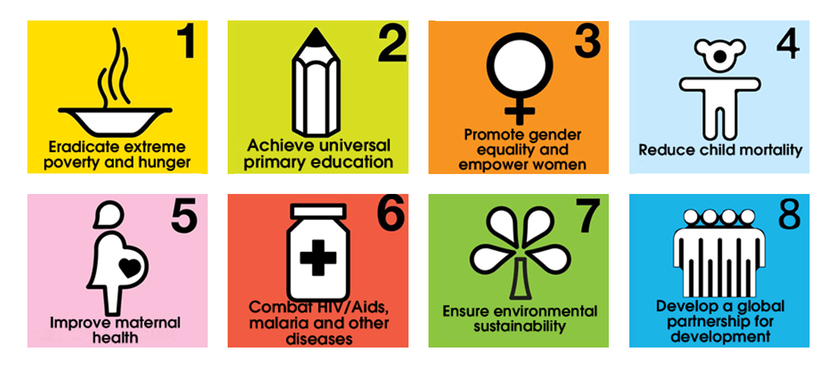
Voorganger: Millennium Development Goals (MDGs), 2000-2015

Slide 10
Notes:
Wat hebben de MSG’s opgeleverd?
https://www.brookings.edu/wp-content/uploads/2018/02/Change-of-Pace_Accelerations-and-advances-during-the-MDG-era.pdf
Samenvatting: “We find that low-income countries and sub-Saharan African countries had positive acceleration on a majority of indicators and accounted for much of the world’s post-2000 accelerations. Middle-income countries typically registered larger cumulative gains but less acceleration over the period. The greatest advances were in matters of life and death. At least 20.9 million and as many as 30.3 million additional lives were saved (…)
Environmental indicators showed no systematic evidence of faster progress.”

Slide 11
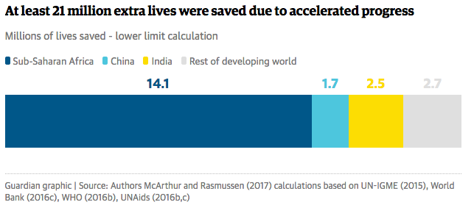

Slide 12
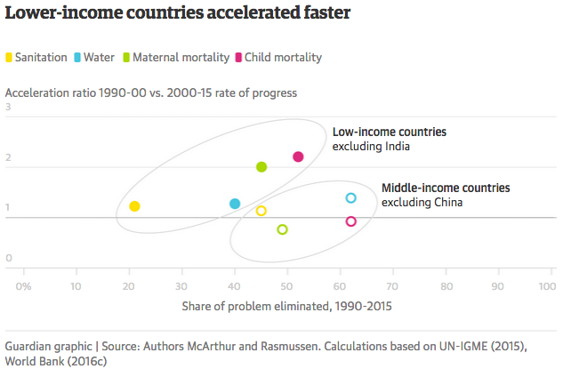

Slide 13
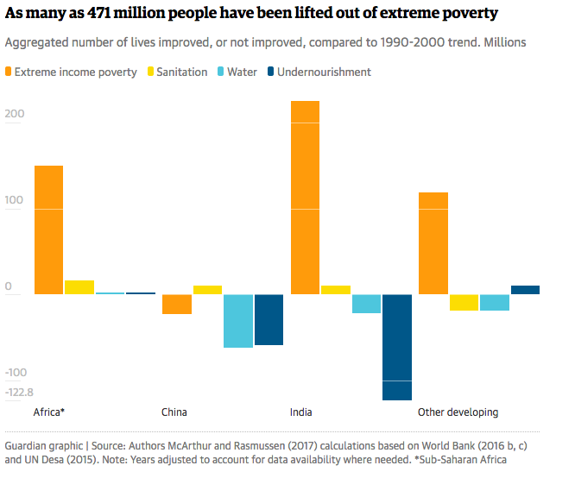

Slide 14
Maar…
“pathways of cause and effect are difficult to discern”
outcomes on basic needs were mixed. The diversity of trends prompts clear questions of why: What differences in public and private action led to such different results across geographies and issues?
Answering such questions is crucial if the world is going to have a shot at achieving the UN’s ambitious SDG’s for 2030.

Slide 15
Verschillen
MDG | SDG
Doel: Halveren honger, | Doel: Statistische nul ‘leave no one behind’
Arme landen aan het werk, rijke landen doneren | Iedereen moet aan het werk
8 losse doelen | 17 met elkaar verbonden doelen
Nadruk op primaire noden: honger, extreme armoede, sterfte | Brede agenda, meer aandacht voor milieu en lange termijn
Top down | Bottom up
‘Monitoring, evaluation and accountability’ ontbraken | Poging tot het verzamelen en vergelijken van data
Notes:
https://advocacy.thp.org/2014/08/08/mdgs-to-sdgs/

Slide 16
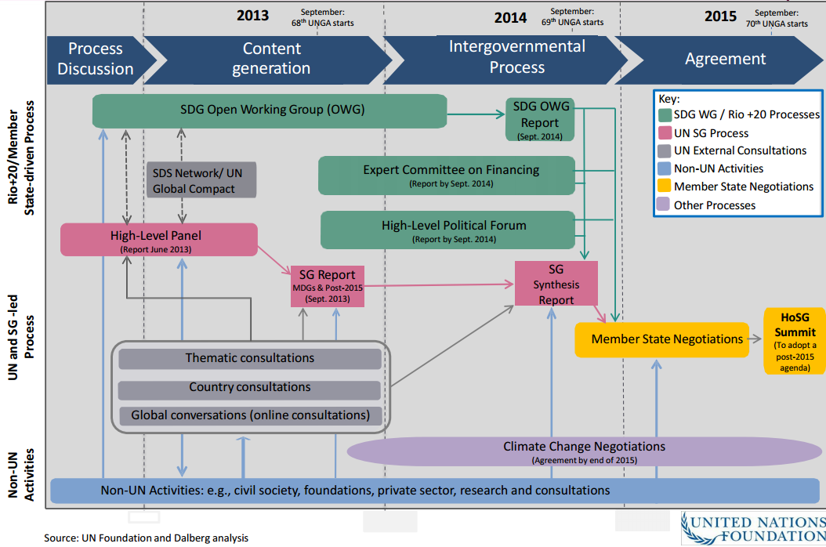
Notes:
OWG=open working groups; SG = Secretary General
Plaatje dat het ingewikkelde proces laat zien hoe de SDG’s tot stand kwamen.
“MDGs were drawn up by a group of experts in the ‘basement of UN headquarters’ whereas SDGs have evolved after a long and extensive consultative process including 70 Open Working Groups, Civil Society Organizations, thematic consultations, country consultations, participation of general public through face-to-face meetings and online mechanisms and door to door survey;”
MDGs had no concrete role for the Civil Society Organizations (CSOs), whereas SDGs have paid attention to this right from the framing stage itself with significant engagement of civil society actors.

Slide 17
Holistische aanpak
Don’t think of them as “17” but as “1.” The SDGs recognize that the challenges of poverty, hunger, conflict, the environment and discrimination are inextricably linked and can only be solved through an integrated approach. You will hear people say “Goal X (fill in any number 1 to 17) is really the key to solving all the others” and they will be right in a way. But if you focus on any goal without fully taking account the complete system, the SDGs will not succeed.
Notes:
https://advocacy.thp.org/2017/10/30/top-10-how-to-think-about-the-sdgs/

Slide 18
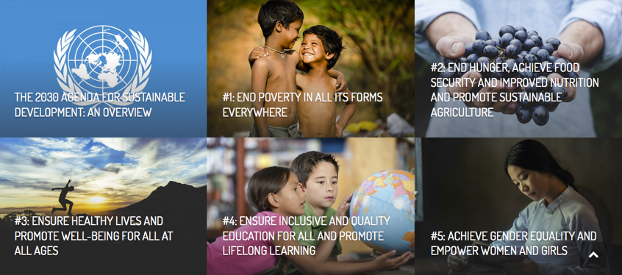
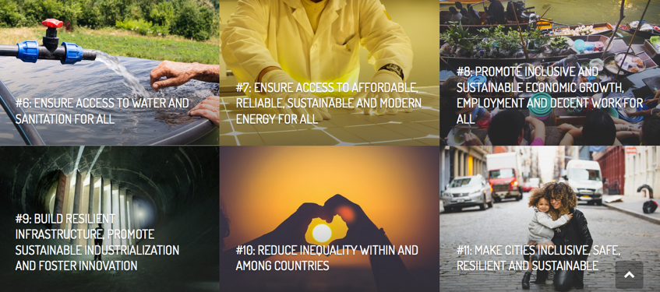
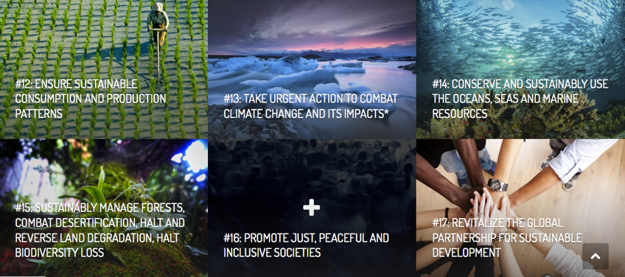
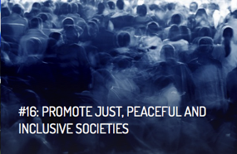
Each goal is
important
in itself …

Slide 19
Each goal is
important
in itself …
And they
are all
connected

Slide 20
SDG’s > #GlobalGoals campagne
https://www.youtube.com/watch?v=RpqVmvMCmp0&t=61s
Notes:
Geknipt filmpje.
Prachtig! Wij ‘the people’ gaan ervoor! Maar er zijn ook kanttekeningen en belangrijke vragen tav SDGs.

Slide 21
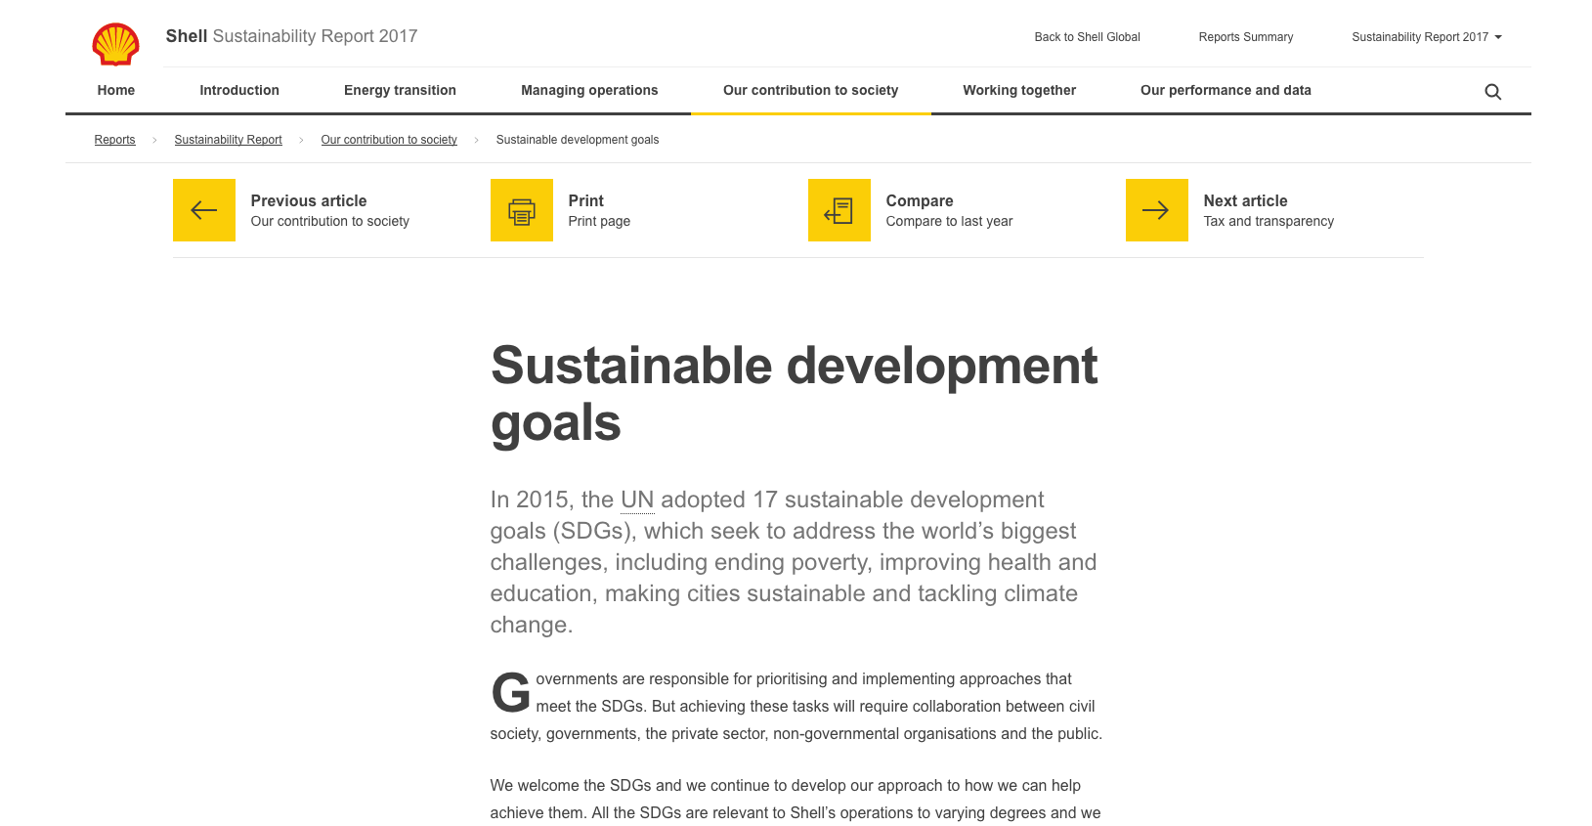
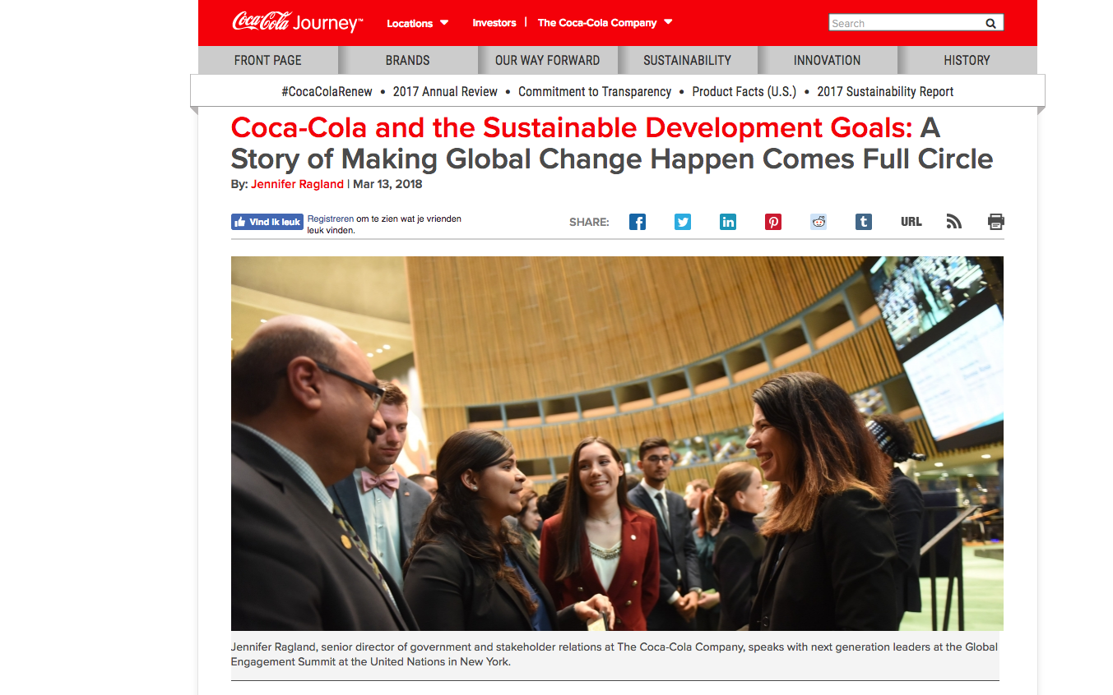
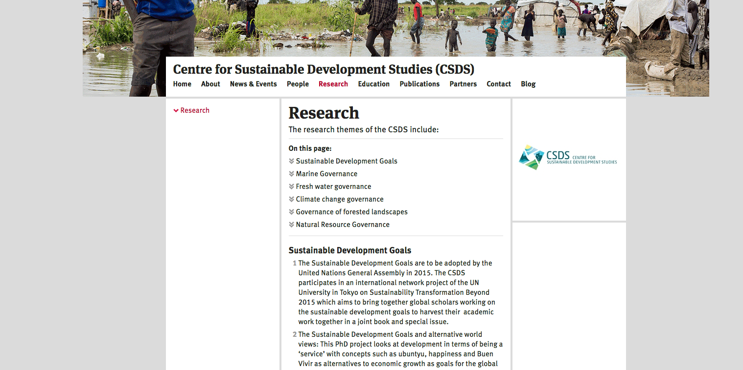
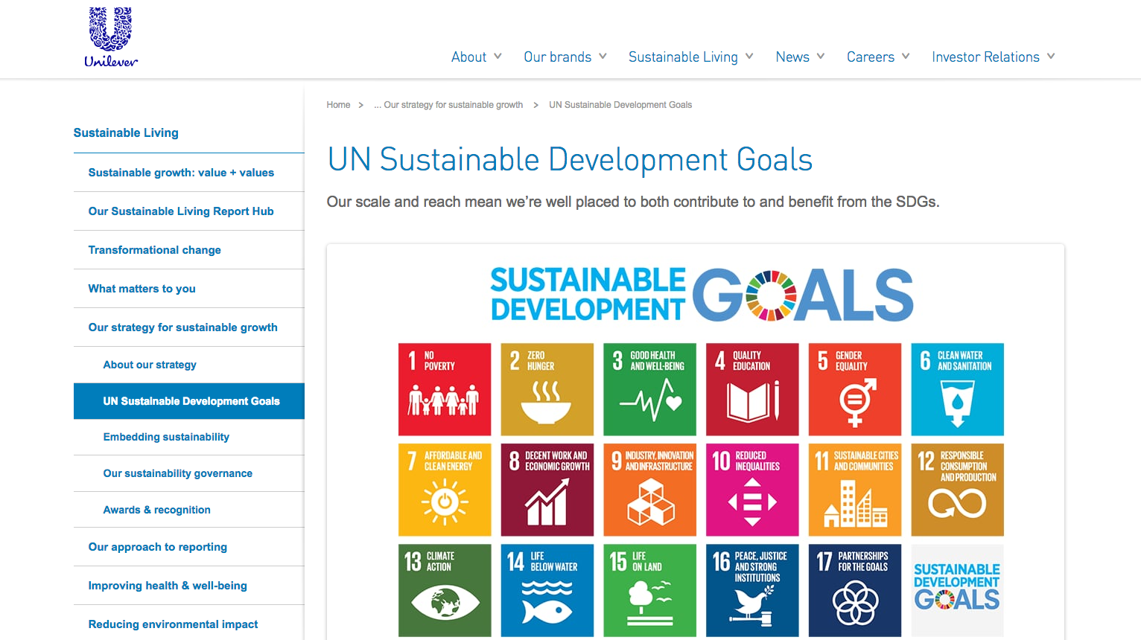
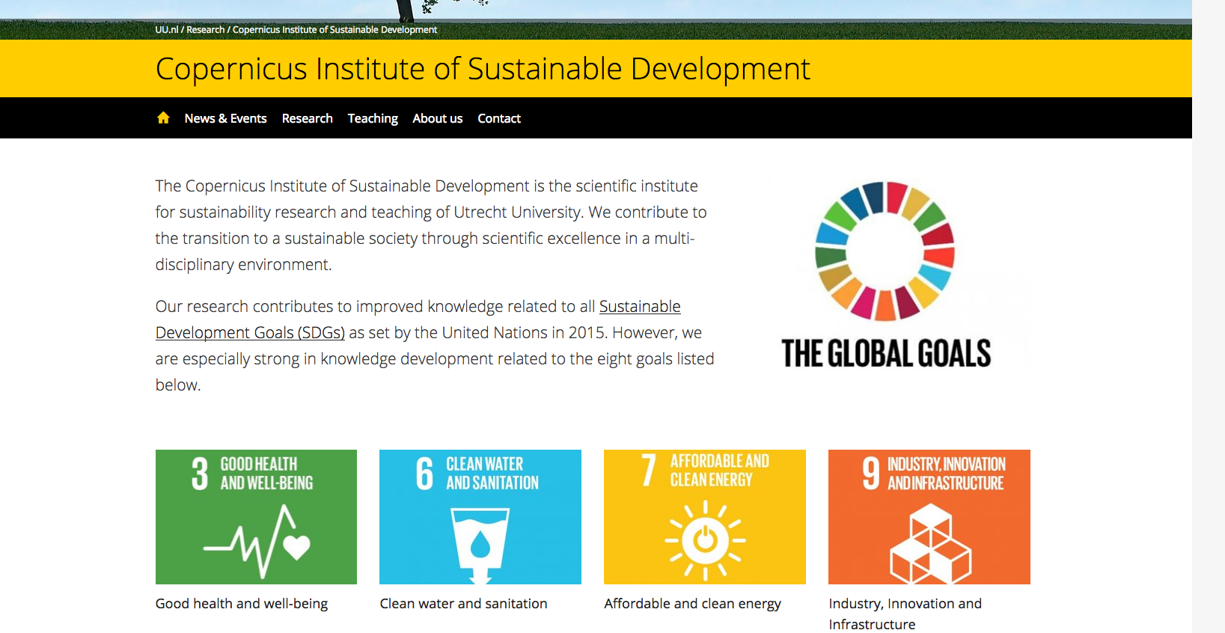
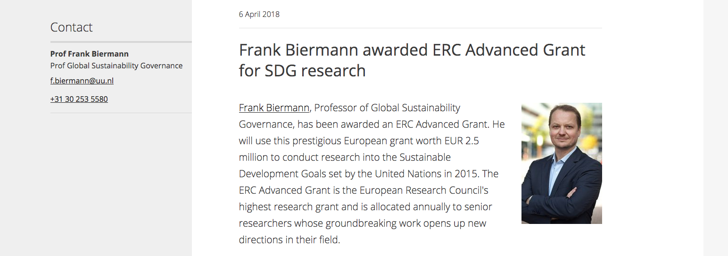
SDG’s: voor de show/goede sier?
Notes:
Funding gap? https://www.weforum.org/agenda/2018/07/how-to-measure-progress-sustainable-development-goals/
“The SDGs' remaining finance requirements are estimated at between $1.4 trillion and $2.5 trillion” =
1,5-2,5 biljoen = duizend miljard (12 nullen!): $1,5 a 2,5 000,000,000,000

Slide 22
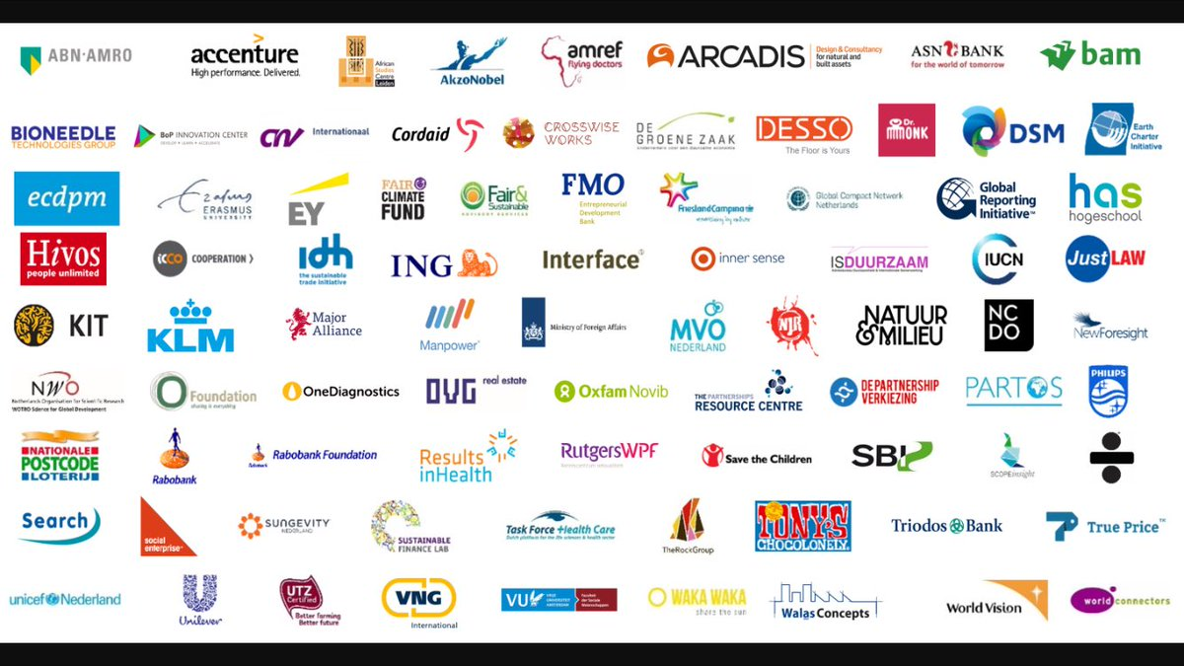
SDG Charter
The SDG Charter Network enables business, civil society & local governments in the Netherlands to cooperate effectively in achieving the U.N. Sustainable Development Goals, at home and abroad.
Notes:
https://www.sdgcharter.nl/
“The SDG Charter Network enables business, civil society & local governments in the Netherlands to cooperate effectively in achieving the U.N. Sustainable Development Goals, at home and abroad. The Charter develops an ambitious, positive agenda to achieve the goals. The SDGs are a great opportunity for the Netherlands and the world, if we are able to work together. The SDG Charter has been signed by over 250 parties; companies, civil society & youth organizations, foundations, knowledge institutes and municipalities, that are strongly committed to realizing the 2030 Agenda. This is a unique movement in the world. The Charter Bureau facilitates the network by convening actors and catalyzing cooperation. “

Slide 23
#17: Revitalize the global partnership for sustainable development
Notes:
Goal 17: Partnerships for the goals
http://www.sdgfund.org/goal-17-partnerships-goals
“The SDG Fund has introduced the use of matching funds that are provided by national and local governments, international donors and the private sector. This increases sustainability, impact, national ownership and the potential to scale up. 55% of the overall SDG Fund programme budget comes from matching funds.”
HARD NODIG, want Noordelijke Overheden hebben minder geld over voor ontwikkelingssamenwerking; velen halen VN norm van 0,7% van BNP niet; NL betaalde vroeger 1% maar dit is sterk gedaald en bovendien MIX HULP&HANDEL

Slide 24
Kanttekeningen bij SDGs
Eén agenda voor iedereen? Grote verschillen in omstandigheden: sociaal, economisch, politiek, cultureel
Alles is belangrijk, is dat realistisch? Wat te doen met trade-offs?
Soft politics van VN versus harde belangen van bedrijven, staten, rijken
Zelfrapportage en meetbaarheid van de voortgang
Beperkte animo bij sociale bewegingen in ontwikkelingslanden; missing link tussen de mondiale agenda en de lokale organisaties die dezelfde doelen in praktijk proberen te realiseren

Slide 25
Zijn de juiste prioriteiten gesteld?
Poverty cannot be eradicated without focusing on justice
(Amitabh Behar, National Foundation for India, 2016)
I saw they put justice and peace at the end instead of the beginning
(Laura Ortiz Montemayor, Mexican social entrereneur, 2018)
Notes:
11.10.2016 | Sustainable Development Goals: Possibilities and Challenges
Guest commentary by Amitabh Behar, Executive Director, National Foundation for India.
https://www.welthungerhilfe.org/news/latest-articles/sdgs-the-possibilities-and-challenges/

Slide 26
Gaan SDG’s wel tot de kern van problemen?
SDG’s gericht op “Promoting international trade, and helping developing countries increase their exports, is all part of achieving a universal rules-based and equitable trading system that is fair and open, and benefits all.”
Kritiek: SDG’s do not address the fundamental causes of poverty like extractive industries; unequal terms of trade; … and market fundamentalism
(Amitabh Behar, National Foundation for India, 2016)
Kritiek op SDG2 “Zero Hunger” in plaats van “Food Sovereignty”:
Indigenous communities in Mexico are losing their ability to grow their own food in Milpa style (using permaculture). Increasingly they are becoming consumers of junk food that is sometimes cheaper, more accessible and less labor intensive
(Laura Ortiz Montemayor, 2018)
Notes:
The trouble with the UN SDGs 2030 global goals
As we invest trillions of dollars in sustainable development, let’s tackle the root causes of the problems we’re trying to solve
Laura Ortiz Montemayor May 3, 2018
“junk food that is sometimes cheaper, more accessible and less labor intensive”: COCA COLA!!
Soft policy (VN) versus harde belangen van bedrijven, staten, rijken

Slide 27
Gaan SDG’s wel tot de kern van problemen?
SDG2 luidt “No Hunger” in plaats van “Food Sovereignty”
Indigenous communities in Mexico are losing their ability to grow their own food in Milpa style (using permaculture). Increasingly they are becoming consumers of junk food that is sometimes cheaper, more accessible and less labor intensive
(Laura Ortiz Montemayor, Mexican social entrereneur, 2018)
Notes:
The trouble with the UN SDGs 2030 global goals
As we invest trillions of dollars in sustainable development, let’s tackle the root causes of the problems we’re trying to solve
Laura Ortiz Montemayor May 3, 2018
“junk food that is sometimes cheaper, more accessible and less labor intensive”: COCA COLA!!

Slide 28
Technocratisch en vrijwillige nationale rapportage
SDG-tracker.org, bijv. Target 15.2: End deforestation and restore degraded forests. SDG Indicator 15.2.1 Sustainable forest management: progress towards sustainable forest management.
SFM is composed of five sub-indicators that measure progress towards all dimensions of sustainable forest management. Three sub-indicators focus on the extension of forest area, biomass within the forest area and protection and maintenance of biological diversity. One relates to the availability of a long-term management plan; and the final measures areas which are independently verified for compliance with a set of national or international standards.
Notes:
Niet echt toegankelijk voor ‘we the people’
Huidige stand van zaken: https://sdg-tracker.org/ ; boeiende data maar best ingewikkeld, echt iets voor experts!
Bijv Target 15.2: End deforestation and restore degraded forests:
UN definition: By 2020, promote the implementation of sustainable management of all types of forests, halt deforestation, restore degraded forests and substantially increase afforestation and reforestation globally.
SDG Indicator 15.2.1 Sustainable forest management
Definition: Indicator 15.2.1 is progress towards sustainable forest management.
Sustainable Forest Management (SFM) is composed of five sub-indicators that measure progress towards all dimensions of sustainable forest management.
Three sub-indicators focus on the extension of forest area, biomass within the forest area and protection and maintenance of biological diversity. One relates to the availability of a long-term management plan; and the final measures areas which are independently verified for compliance with a set of national or international standards.
OFTEWEL: transparantie maar wereldwijd en complex; als leek en zelfs als bijv gemiddelde NGO die voor bosbescherming werkt niet makkelijk mee kan werken

Slide 29
Bottom up aanpak?
The SDGs apply at every level. Similarly, the SDGs recognize that progress is not just the job of national governments. In fact, many of the key challenges must be solved in local communities.
MAAR daar is een groot probleem:
the SDGs are pushing an agenda carefully calibrated to avoid upsetting the world’s dictators, kleptocrats, and this century’s worst human rights offenders. Search the 17 SDGs and you will fail to find a single mention of the word “democracy.” Out of thousands of words of text, “human rights” is mentioned merely once (and not as its own category, but as a secondary bullet point).
(Jeffrey Smith, Robert F. Kennedy Partners for Human Rights, 2018)
Notes:
https://qz.com/africa/1299149/how-the-uns-sustainable-development-goals-undermine-democracy/

Slide 30
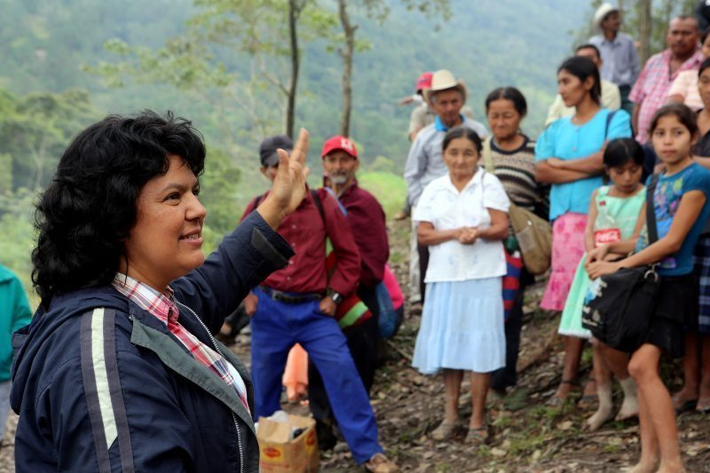
Empowerment van gemeenschappen en activisten? 2017 was deadliest year for environmental activism Global Witness: At least 207 activists were killed, with Brazil, the Philippines and Colombia named as the most dangerous countries
Notes:
GW rapport 2018
Philippines has highest number of killed environmental defenders in Asia ; 48 individuals were killed in the country last year, a majority related to agribusiness.
Berta Cáceres, Honduras, strijd tegen waterkrachtcentrale

Slide 31
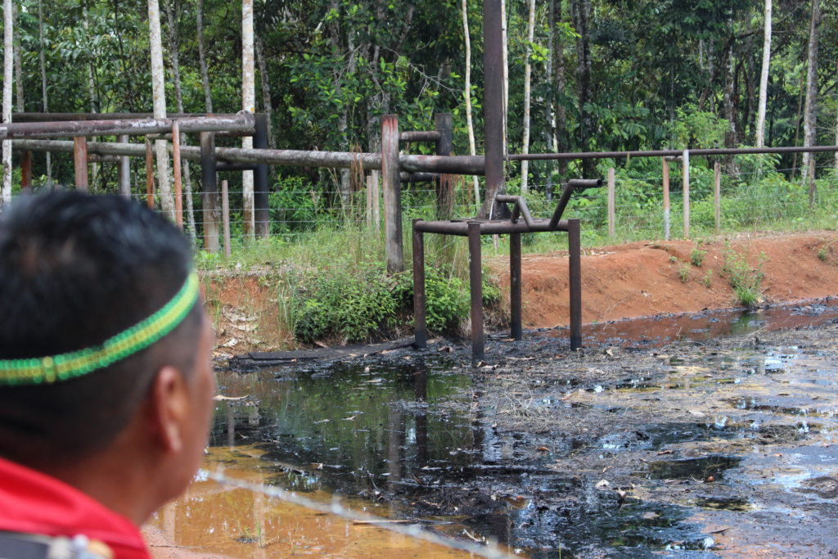
Trade-off’s tussen SDG’s?
Leave fossil fuels underground versus olie voor vooruitgang – bijv. in Ecuador
Armoedebestrijding – SDG1
Investering in infrastructuur en innovatie – SDG9
Klimaatactie – SDG13
Natuurbescherming – SDG15
Notes:
Olieland, ontwikkelinsgland, Amazone, biodiversiteit
SDGs zijn mooie doelstellingn, in de praktijk van alle dag zijn er altijd trade-offs; helpen SDGsom daar mee om te gaan?

Slide 32
Hoe verder?
Notes:
Moeten we het kind met het badwater weggooien?

Slide 33
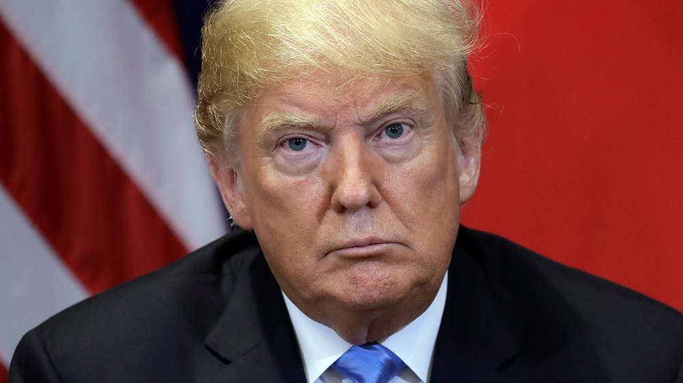
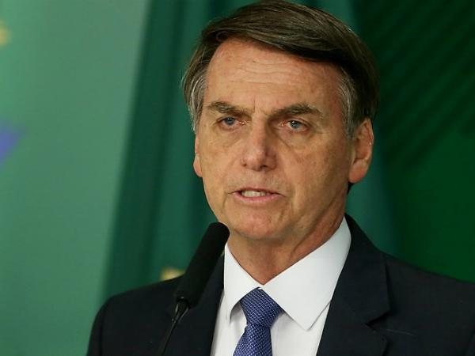
Hoe verder?
Mondiale verhoudingen anno 2019 vragen om realisme: toenemende politieke spanningen, nationalisme i.p.v. multilateralisme, klimaatakkoord onder druk, etc
Notes:
Onder huidige verhoudingen lijkt een betere mondiale agenda niet haalbaar; dus koester het kind en ververs het badwater: oa link met de mensen en instanties die dagelijks hard werken richting de doelstellingen

Slide 34
Voorbij blije boodschappen en gekleurde plaatjes
SDGs vragen om radicale veranderingen en pijnlijke keuzes
SDGs vragen om rigoreus monitoren door verschillende actoren
SDGs vragen om solidariteit met de mensen die er hard aan werken en er echte risico’s voor nemen

